Slide 1

telco customer churn analysis business analytics case study
OSALOBO EGHOSA
DATA ANALYST | FINANCIAL ANALYST

Slide 2
Business problem statement
Business Challenge
Customer churn remains one of the most significant challenges in the telecommunications industry. Every customer who leaves results in lost revenue, higher customer acquisition costs, and decline in overall customer lifetime value.
Key Questions
Why are customers leaving the company?
Which customer segments are most likely to churn?
Which business factors influence churn?
How can retention be improved?
26.54%
Churn Rate%

Slide 3
DATASET summary
Dataset Description
The Telco Customer Churn datasets contains customer demographic information, service subscriptions, billing details, and churn status.
Datasets Summary
KPIs | Value
Churn Rate | 26.54%
Churned Customers | 1,869k
Active Customers | 5,174k
Total Customers | 7,043k
Avg Tenure | 32.37

Slide 4
Datasets overview
Key Variables Data Preparation
Senior Citizen ~ Checked data quality
Tenure ~ Created Tenure Group
Churn ~ Created Monthly Charges Groups
Gender ~ Developed Churn measures using DAX
Partner ~ Created Correlation Heatmap
Contract Type
Dependents
Internet Service
Payment Method
Monthly Charges
Total Charges

Slide 5
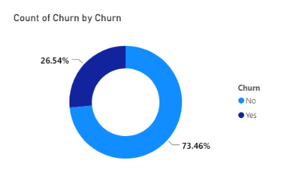
EXECUTIVE OVERVIEW FINDINGS
Overall Churn Performance
Key Findings
The overall churn rate stands at 26.54%.
Approximately 1 in 4 customers have discontinued using the company’s services.
Active customers still make up the larger share of customer base.
Customer retention continues to pose a major business challenge.
BUSINESS IMPLICATION: Even a modest reduction in the churn rate could significantly improve revenue retention and contribute to stronger long-term business growth.

Slide 6
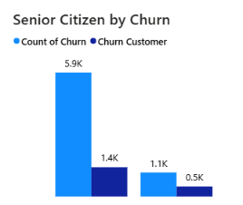
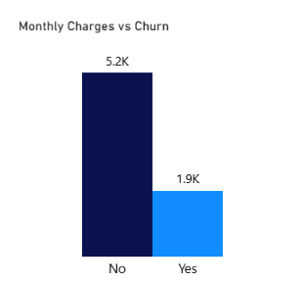
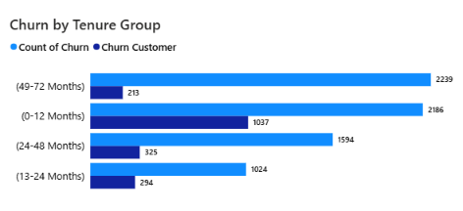
Customer churn analysis
Which Customers are leaving?
Findings
Tenure: Customers with shorter service durations are considerably more likely to churn, while those with longer tenures tend to remain loyal.
Monthly Charges: Customers with higher monthly subscription fees have a greater likelihood of discontinuing the services.
Senior Citizens: Churn is slightly more prevalent among senior citizens than among non-senior customers.
Business Implication: The findings suggest that businesses should prioritize targeted retention initiatives for newly acquired customers and subscribers with higher monthly charges to improve customer loyalty and reduce churn.

Slide 7
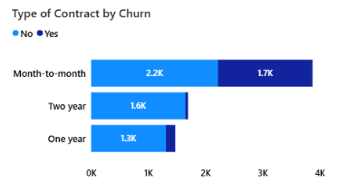
Internet service and contract analysis
Findings
Churn by Contract Type
Customers with Month-Month contracts have the highest churn rate
Customers with one-year and two-year contracts are more likely to stay.
Internet Service
Fiber Optic customers experience the highest churn.
DSL and No internet customers demonstrate stronger retention.
Business Implication: Contract commitment and service experience strongly influence customer retention.

Slide 8
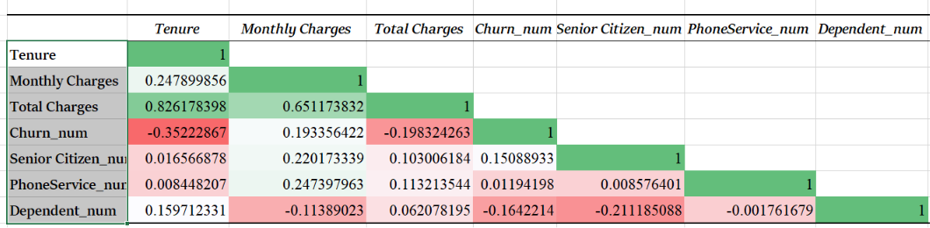
Churn Driver and correlation analysis
The correlation analysis indicates that customer tenure is the strongest driver of churn, with a moderate negative correlation (-0.352), suggesting that newer customers are more likely to leave the company. Monthly Charges show a weak positive relationship with churn (0.193), indicating that customers paying higher monthly fees have a slightly greater tendency to churn. Total Charges (-0.198) and Dependents (-0.164) exhibit weak negative relationships with churn, suggesting that long-standing customers and those with dependents are somewhat more likely to remain. Senior Citizen status has only a weak positive relationship with churn (0.151), while Phone Service (0.012) has virtually no impact on customer churn.

Slide 9
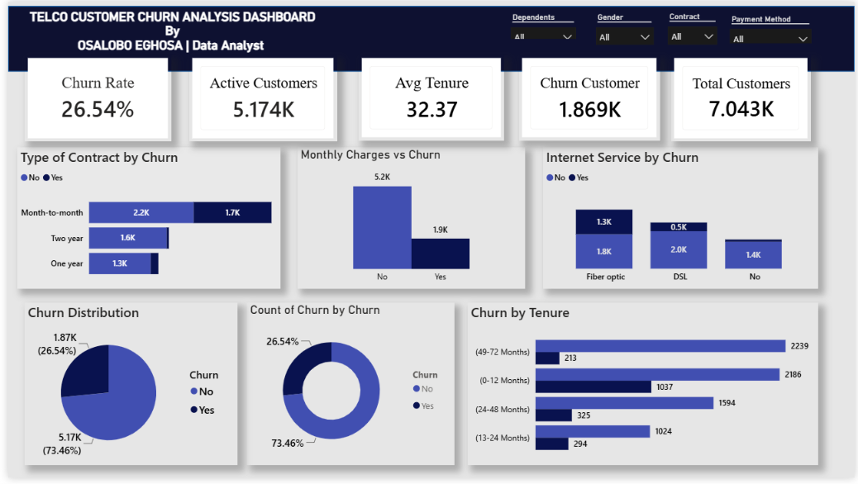
Dashboard overview

Slide 10
Conclusion
The analysis indicates that customer churn is largely driven by the following factors:
High monthly charges.
Short customer tenure.
Subscriptions to Fiber Optic services.
Limited adoption of value-added services.
Final Insights
To address these challenges, the company should strengthen customer retention strategies by encouraging contract upgrades, enhancing service quality, and increasing customer engagement. Implementing these initiatives can help reduce churn, improve customer loyalty, and drive long-term profitability.

Slide 11
recommendation
Strengthen Customer Onboarding
• Implement retention initiatives during customers’ first year.
• Increase engagement through regular communication and personalized support after signup.
Promote Long-Term Subscriptions
• Encourage customers to choose annual contracts by offering attractive discounts.
• Introduce loyalty and rewards programs to improve long-term retention.
Enhance the Fiber Optic Service Experience
• Evaluate and resolve service quality concerns affecting Fiber Optic users.
• Review pricing to ensure customers perceive better value for the service.
Expand Adoption of Value-Added Services
• Bundle services such as Online Security and Tech Support with existing plans.
• Educate customers on the benefits of these additional services to drive adoption.
Refine Pricing and Retention Strategies
• Provide personalized offers and retention incentives for customers with higher monthly charges to reduce churn.

